Slide 1
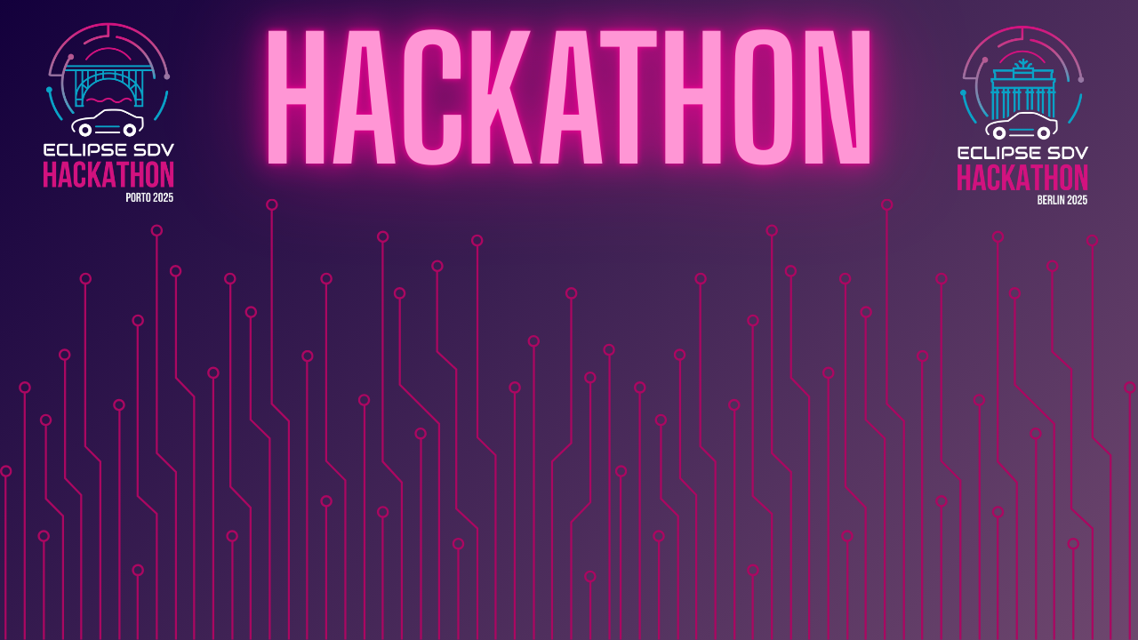

Chapter III - 2025
COPYRIGHT (C) 2025, ECLIPSE FOUNDATION

Slide 2
PITCHING SESSION
WALMOPS
COPYRIGHT (C) 2025, ECLIPSE FOUNDATION

Slide 3


Idea Solution Plan
INTERSECTION
TRAFFIC JAMS
Caused by the
uncoordinated + irrational + inefficient
motion of the vehicles
Our Idea: what if the vehicles could accelerate together at yield?
what if the vehicles could become a Train?
Our Solution: an SDV based, OEM agnostic, Vehicle2Vehicle coordinator
Our Plan: Leverage the Open Source Eclipse SDV software to obtain a seamless control and communication between vehicles
COPYRIGHT (C) 2025, ECLIPSE FOUNDATION
‹#›

Slide 4
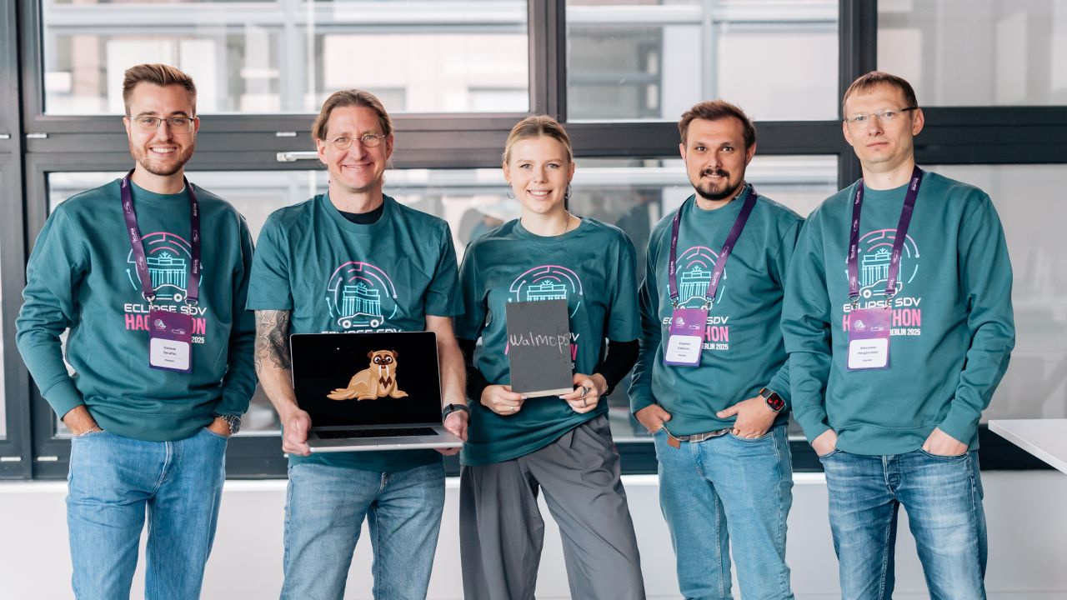
Team and Structure
COPYRIGHT (C) 2025, ECLIPSE FOUNDATION
‹#›

Slide 5





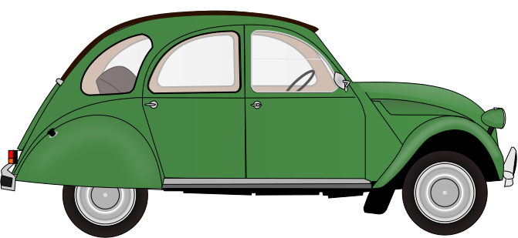
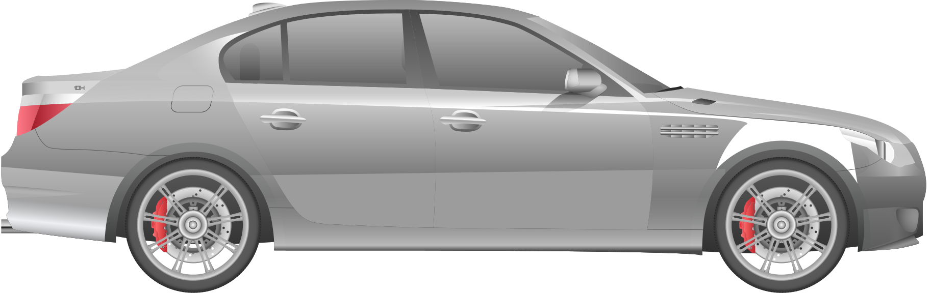
The Product / Service
V2V
Comunication
Acceleration suggested
Acceleration applied
SDV
Coordinator
SDV
Coordinator
AD OEM
controller
AD OEM
controller
FOLLOWER
SDV LINK
LEADER
COPYRIGHT (C) 2025, ECLIPSE FOUNDATION
‹#›

Slide 6
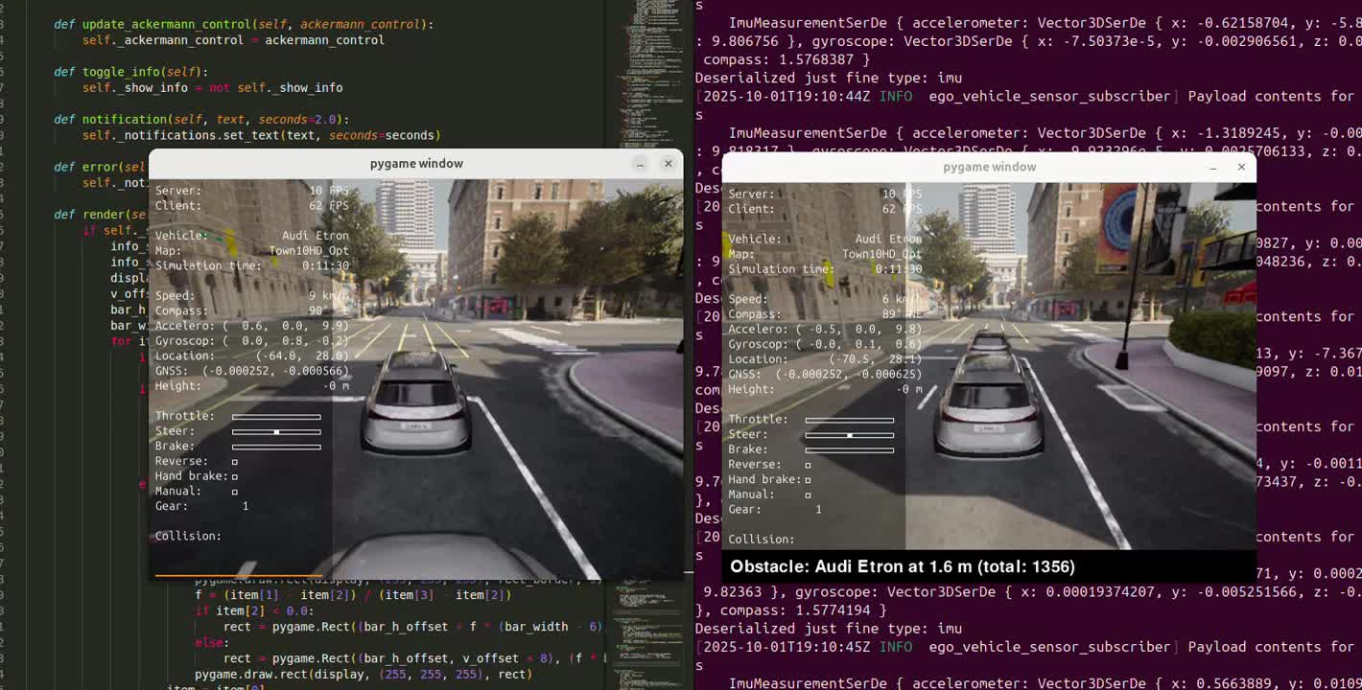
COPYRIGHT (C) 2025, ECLIPSE FOUNDATION
‹#›

Slide 7
The Added Value
Real life problem solver
Flexibility of application
SDV OEM Agnostic
V2V
According to IAmExpat, in Munich drivers lost 56 hours a year in traffic jams
It can be applied in any traffic jam situation:
intersections, highway, yield situations
The solution leverages the open source SDV to suggest an acceleration, independent of the OEM producer
The solution does not focus only on one vehicle,
but coordinates 2 or more vehicles
COPYRIGHT (C) 2025, ECLIPSE FOUNDATION
‹#›

Slide 8
Thank you Eclipse Foundation
Thank you Berlin!
COPYRIGHT (C) 2025, ECLIPSE FOUNDATION

